Slide 1
Educational materials developed through the Baltimore County History Labs Program, a partnership between Baltimore County Public Schools and the UMBC Center for History Education. RS#15 Guatemalan Coup Power Point
The Guatemalan Coup of 1954: How Did the Cold War Influence American Foreign Policy Decisions?
What motivated the United States Government to authorize the CIA-sponsored Guatemalan Coup of 1954: Containment or Bananas (protecting American business interests)?

Slide 2
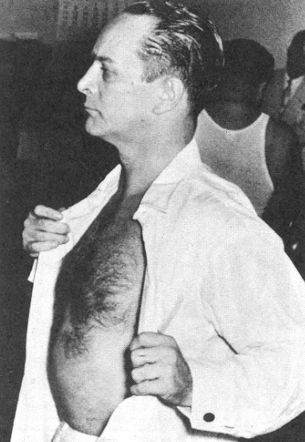
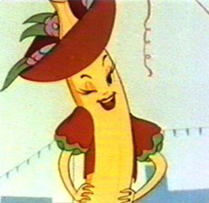
Warm-Up: Making Connections Please take out your homework

Slide 3
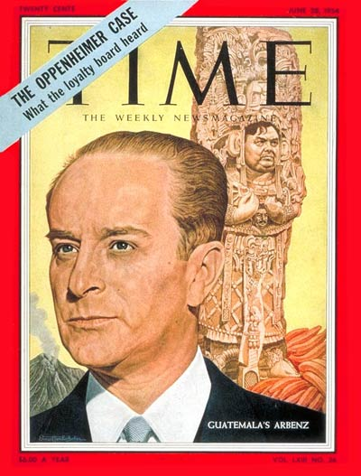
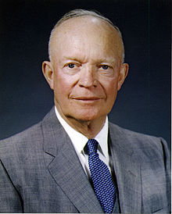
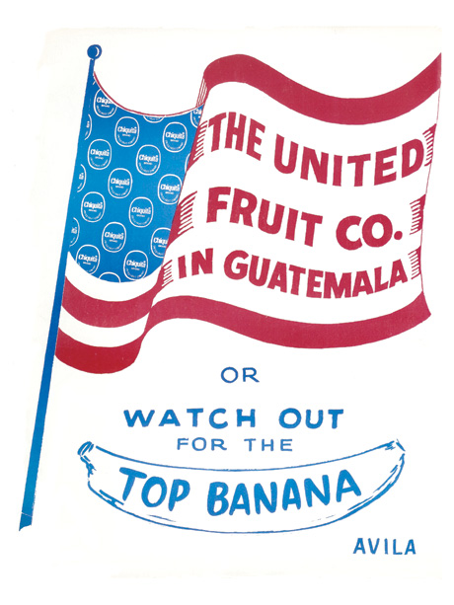
Jacobo Arbenz
President of Guatemala
President Dwight D. Eisenhower

Slide 4
Motivations of the Major Players
Contain Communism AND protect American business interests.
Keep cheap land and banana empire in Guatemala. Continue making large profits in Guatemala by growing and selling bananas.
Overthrow Arbenz, with the help of the United States and become the (U.S. appointed) President of Guatemala.
Remain the elected President of Guatemala. Redistribute land to poor farmers.

Slide 5
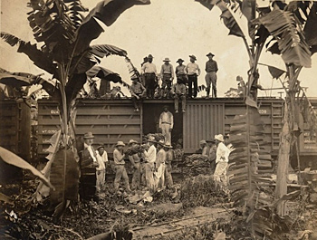
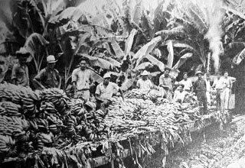
A Banana Republic
A politically unstable country that depends economically upon the export of a limited resource (fruits, minerals), and usually features a class-based society, with a large, impoverished working class and wealthy élites in business, politics, and the military.

Slide 6
Timeline to Coup
1944 Free Elections in Guatemala -
Dr. Arevalo Elected (Liberal Politician)
New Constitution, Corrupt Dictator Gone
1950 Col. Arbenz Elected (extends political freedoms to all citizens)
1952 225,000 Acres of Land Confiscated;
Compensation to Owners is Based on Amount Declared on Taxes
1952 United Fruit Company Enraged; Eisenhower Elected on Platform of Reducing Military Spending

Slide 7
1952 Government and United Fruit Company begin Anti-Communist Propaganda Campaign in Guatemala; Investigate Arbenz
1954 CIA orchestrates and carries out an overthrow of Guatemalan Government using only 150 men;
Armas Invades with Support of the United States;
Arbenz Resigns due to Pressure;
Armas Appointed Leader/Liberator

Slide 8
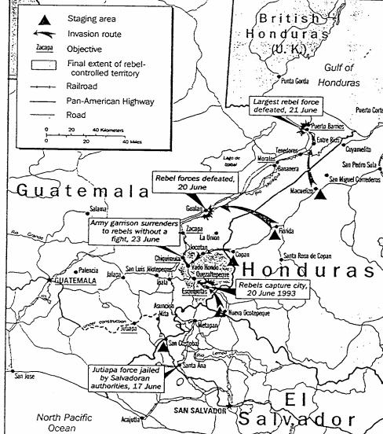
Invasion of Guatemala
June 1954

Slide 9
Why did the United States Government overthrow the Government of Jacobo Arbenz in Guatemala: Bananas or Containment?

Slide 10
CIA (Central Intelligence Agency)
Created during WW2 to spy on Axis powers
Collects information about foreign governments and individuals
Conducts emergency tactical operations and carries out covert operations

Slide 11
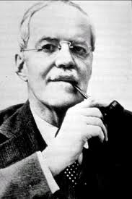
Allen Dulles Director of CIA; Owns Shares of UFCO; Serves on Board of the Company

Slide 12
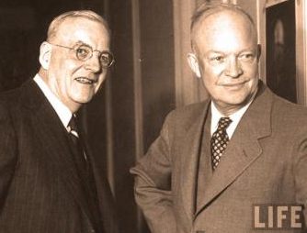
John Foster Dulles U.S. Secretary of State; Brother of Allen Dulles; Law Firm Represents the United Fruit Company

Slide 13
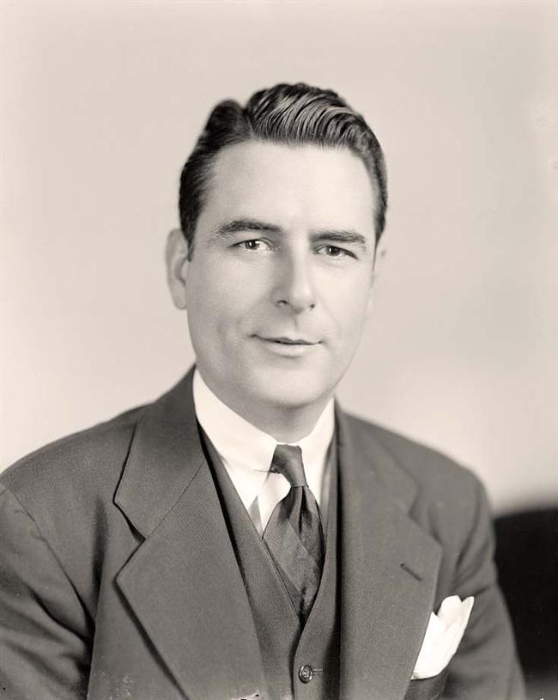
John E. Peurifoy U.S. Ambassador to Guatemala; State Department's Ace Troubleshooter in Communist Hotspots

Slide 14
How are they ALL Connected?
Why did the United States Government Overthrow Arbenz in Guatemala: Bananas ($$) or Containment?
John F. Dulles Sec. of State
Allen Dulles
Head of the CIA
Brothers
Law Firm Sullivan and Cromwell
Board of Directors for the UFCO
Shareholder of the UFCO
United Fruit Company
President Eisenhower
Public Relations Officer for UFCO -- Ed Whitman
Personal Secretary
Ann Whitman

Slide 15
As a group, decide if your sources provide proof for bananas or for containment, and where in the sources that is conveyed. Be prepared to explain.

Slide 16
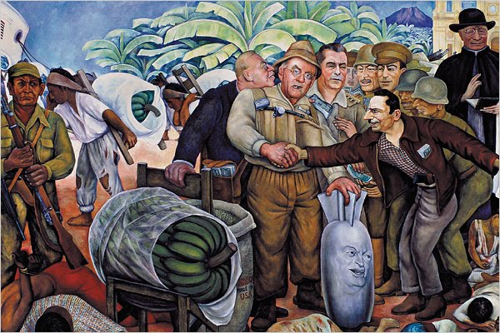

Slide 17
The two most important pieces of evidence are…because…
The two pieces of evidence that contradicted the most are…because…
The two pieces of evidence that most complement each other are…because…
The two pieces of evidence that present the most difficulty are…because….

Slide 18
Rank your evidence from the most to the least useful in proving your interpretation as to why the United Sates overthrew President Arbenz of Guatemala.

