Slide 1

Day

Slide 2
The day has come for us to take all of our evidence and answer our big question:
“Should the colonists have revolted against Great Britain?”.

Slide 3
Let’s take a look at our primary source documents and the perspectives that each one represents.
Briefly summarize each primary source and perspective.

Slide 4
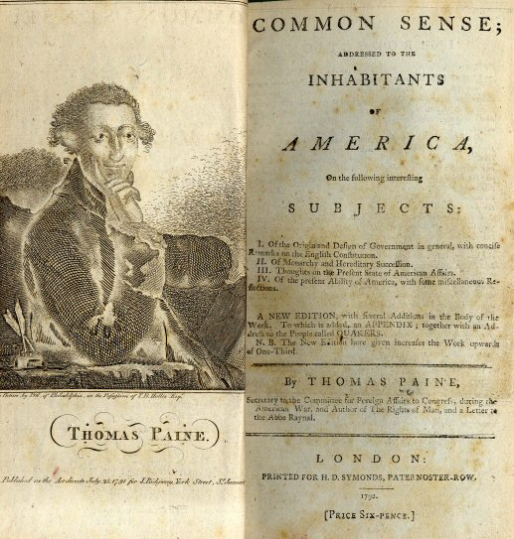

Thomas Paine’s Common Sense

Slide 5
Thomas Paine’s Common Sense
      Paine thinks the colonists should revolt, because he believes the colonies should rule themselves instead of being ruled by a king. He finds fault with monarchies and thinks that kings cause war and the worshipping of false idols. Also, old and young kings can be manipulated by evil people who will destroy the country. Basically, monarchies go against God and cause bloodshed and it is only natural that the colonies have the right to their own government.

Slide 6
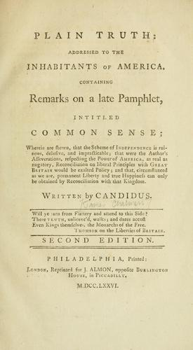
James Chalmer’s Plain Truth

Slide 7
James Chalmer’s Plain Truth
James Chalmers thinks “our country” will be ruined if we try to break away from Great Britain. Democratic countries are wracked with war and we should stay loyal to England to try to avoid war ourselves. We should try to resolve our dispute instead of trying to break away.

Slide 8
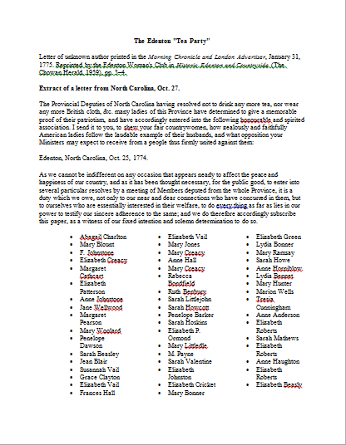
The Edenton Tea Party

Slide 9
The Edenton Tea Party
The ladies who participated in the Edenton Tea Party believed they had to take a stand and demonstrate their support for the tea boycott. They did not want to buy British tea or cloth and owed it their family, friends, and themselves to make a point. We can infer that the women would support a revolt against Great Britain.

Slide 10
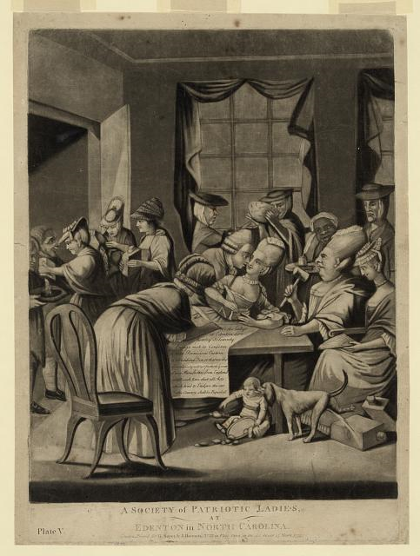
A Society of Ladies, at Edenton in North Carolina—March, 1775

Slide 11
A Society of Ladies, at Edenton in North Carolina—March, 1775
This political cartoon was published in a London newspaper in 1775. The cartoonist wanted to make British society aware of the Edenton Ladies’ Tea Party and the proclamation they organized and signed to not drink British tea. The cartoonist drew the women in elegant clothing, but with male faces, to make fun of the fact that women were getting involved in politics, a historically male role. He also drew the women drinking tea and flirting with men to show that they were not truly serious about their proclamation. By making fun of the women, the cartoonist is making light of the situation and not taking their perspective seriously.

Slide 12
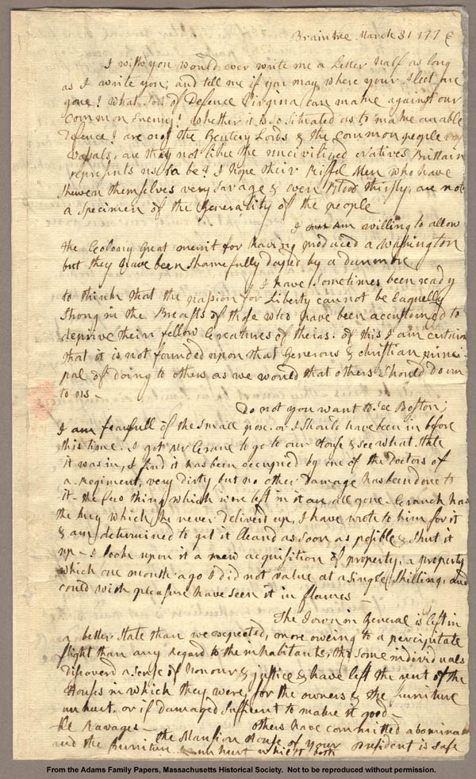
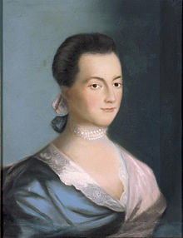
Letter from Abigail Adams to John Adams

Slide 13
Letter from Abigail Adams to John Adams
      Abigail is writing a letter to express her uncertainty about America’s future. She asks John a lot of questions about the type of government America will have and how it will be governed. She is worried about the fate of the country because there are no clear answers. Abigail is neither for nor against a revolt. She seems to want her questions answered before she forms an opinion about the current situation. She does, however, feel that the difficulties of creating a new government can be overcome by patience and perseverance.

Slide 14
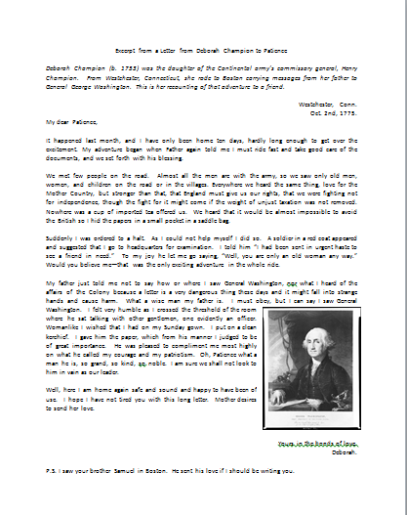
Letter from Deborah Champion to Patience

Slide 15
Letter from Deborah Champion to Patience
      Deborah is the daughter of a Patriot general in Washington’s Continental Army. She works as a messenger, traveling to deliver a very important document to General Washington. Even Washington praises Deborah for her courage and Deborah, in turn, is fond of Washington, calling him “grand, kind, and noble.” She thinks he is a good leader. Deborah clearly thinks the colonists should revolt as she is working for the Patriots and follows General Washington as leader.

Slide 16
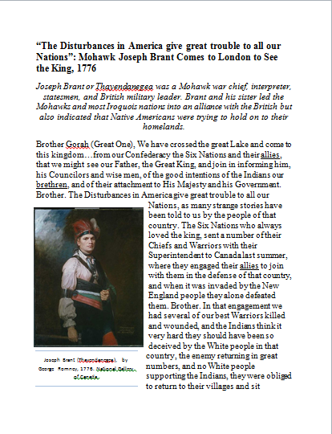
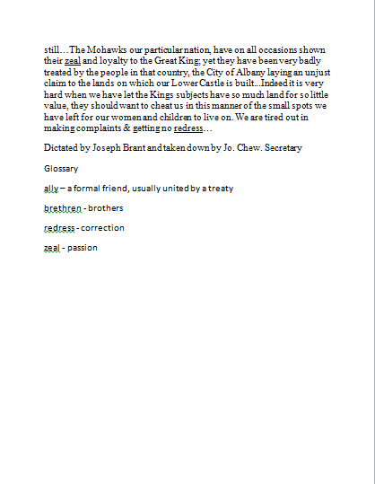
“The Disturbances in America give great trouble to all our Nations”: Mohawk Joseph Brant Comes to London to See the King, 1776

Slide 17
“The Disturbances in America give great trouble to all our Nations”: Mohawk Joseph Brant Comes to London to See the King, 1776
Joseph Brant swears allegiance to the king of England but is not very happy with him. The British soldiers are not helping the Native Americans to defend their land against the colonists and the British people are trying to trick the Indians out of their land. He seems to want the king’s help in punishing the colonists and some of the British subjects.

Slide 18
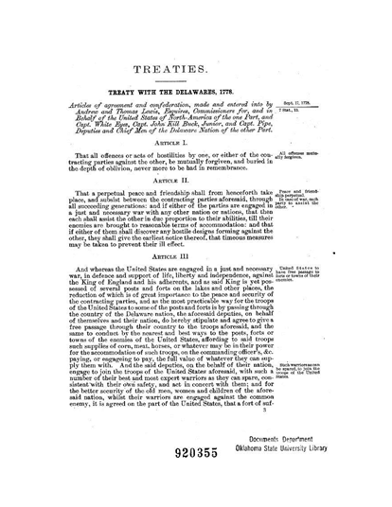
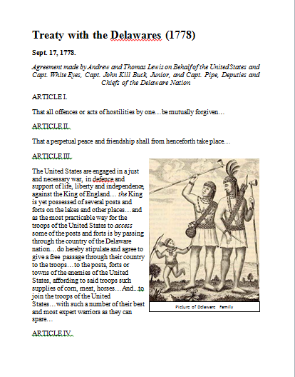
Treaty with the Delawares (1778)

Slide 19
Treaty with the Delawares (1778)
The Delaware Nations sided with the Americans in order to make peace with them and protect their lands. The Native Americas allowed the British to come through their lands to reach enemy forts. They also provided the Americans with supplies and sent strong warriors to help fight the British.

Slide 20
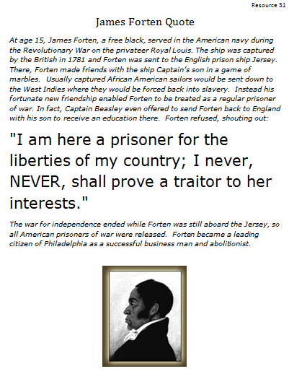
Thumbs up? Thumbs down?

Slide 21
James Forten Quote
James Forten was dedicated to the Patriot cause and helped fight against Great Britain to set the colonists free. When presented with an opportunity to move to England and get a good education, he turned it down because he didn’t want to be a traitor to America. James Forten was part of the military force helping the colonists revolt.

Slide 22
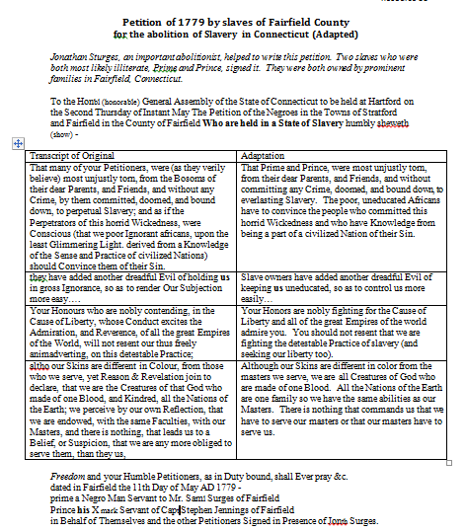
#1 Petition of 1779 by slaves of Fairfield County for the abolition of Slavery in Connecticut

Slide 23
#1 Petition of 1779 by slaves of Fairfield County for the abolition of Slavery in Connecticut

Slide 24
Petition of 1779 by slaves of Fairfield County for the abolition of Slavery in Connecticut
Prime and Prince think that the colonies should revolt against Great Britain because the cause of liberty is a noble cause. They admire the Patriots for fighting for their liberty. They are fighting for a similar cause in their petition. They wish to gain their freedom from the detestable practice and sin of slavery.

Slide 25
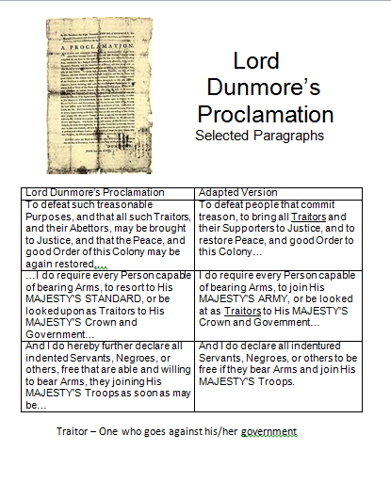
Lord Dunmore’s Proclamation

Slide 26
Lord Dunmore’s Proclamation
Lord Dunmore wrote this proclamation to convince colonists to join the British army. He tells all men that are able to carry a weapon to join. He offers freedom to any slave or indentured servant who joins. Lord Dunmore proclaims that anyone that does not support the British in this revolution is committing treason and is a traitor to his country, Great Britain. Lord Dunmore does not agree with the colonists’ revolt.

Slide 27
Final Assessment
  As a historian, you are now going to demonstrate the new learning you have gained. We will hold a debate to answer our overarching question, “Should the colonists revolt against Great Britain?” Considering all the perspectives we have analyzed and explored this week, take a minute to reflect on each one to form your own opinion. Whether you say yes or no, write down your three strongest points or pieces of evidence to support your thinking. You should look over your history lab document logs to find specific evidence from the many perspectives we have examined.

Slide 28
Break into groups
  Now is the time to get ready for our historical debate. Real historians often disagree about past events, even when presented with the same historical documents. You will get into teams with the other historians who share your opinion.

Slide 29
Directions
    You need to make sure to address your topic and support your opinion with facts. Try to persuade the other students to understand your point of view by making clear and convincing arguments. Every team member needs to get involved in the debate whether you are speaking or working together with the team to come up with the arguments for your debate.

Slide 30
HISTORICAL DEBATE RUBRIC
Category | Presidential Debates | The Senate Floor | Student Council Election | Not Yet | Score
 | 4 | 3 | 2 | 1
Addresses Issues | Always addresses topic | Usually addresses topic | Rarely addresses topic | Did not address topic
Support with Facts | Uses many facts that support topic | Uses some facts that support topic | Uses few facts that support topic | Does not use facts that support topic
Persuasiveness | Arguments clear and convincing | Arguments are sometimes clear and convincing | Arguments are rarely clear and convincing | Arguments are never clear and convincing
Teamwork | Used team member effectively Equal timing | One member does the talking 75% of the time | One member does the talking 100% of the time | No one talks
Organization | Electrifies audience in opening statement Closure convinces audience | Grabs attention Brings closure to the debate | Introduces topic and brings some closure to the debate | Does not introduce topic; no closure

Slide 31
POSITION_________________ TOTAL _________
    In the closing arguments, you want to summarize the debate. Emphasize your most persuasive points and be convincing to your audience. This is also a chance for you to refute the rebuttal which could be fun!
Outline
Opening remarks for Pros (Recorded on chart paper)
Opening remarks for Cons (Recorded on chart paper)
Time to plan rebuttals
Rebuttal for Pros
Rebuttal for Cons
Time to prepare closing remarks
Closing remarks for Pros
Closing remarks for Cons
A rebuttal is your chance to respond to opinions or evidence the opposing side is stating. It would be a good idea to assign some of the students in your group to be secretaries and record statements that the opposing side is making so you can refute them.
Opening remarks should be electrifying! You need to really grab your audience and convince them that your position is the truth. And no interrupting!

Slide 32
It’s time to debate!
Outline
Opening remarks for Pros (Recorded on chart paper)
Opening remarks for Cons (Recorded on chart paper)
Time to plan rebuttals
Rebuttal for Pros
Rebuttal for Cons
Time to prepare closing remarks
Closing remarks for Pros
Closing remarks for Cons

Slide 33
HISTORICAL DEBATE RUBRIC
Category | Presidential Debates | The Senate Floor | Student Council Election | Not Yet | Score
 | 4 | 3 | 2 | 1
Addresses Issues | Always addresses topic | Usually addresses topic | Rarely addresses topic | Did not address topic
Support with Facts | Uses many facts that support topic | Uses some facts that support topic | Uses few facts that support topic | Does not use facts that support topic
Persuasiveness | Arguments clear and convincing | Arguments are sometimes clear and convincing | Arguments are rarely clear and convincing | Arguments are never clear and convincing
Teamwork | Used team member effectively Equal timing | One member does the talking 75% of the time | One member does the talking 100% of the time | No one talks
Organization | Electrifies audience in opening statement Closure convinces audience | Grabs attention Brings closure to the debate | Introduces topic and brings some closure to the debate | Does not introduce topic; no closure

Slide 34
Debate Wrap Up
Have any of your minds been changed due to the debate?
People constantly disagree but as citizens of this country you have the opportunity to participate in public debates, vote, write letters to the newspaper, or contact your representative.

Slide 35
Closing Remarks
What did you learn from this History Lab?
    You learned how to analyze primary source documents in order to answer a question. You learned that you don’t just stop after reading one person’s opinion. You need to look at a variety of perspectives to get the big picture before you form your opinion. And even when you do form your opinion, you need to stay in conversation with other people and respectfully listen to what other people have to say.

Slide 36
Sources for Images
http://www.britishbattles.com/bunker-hill.htm
http://www.sonofthesouth.net/revolutionary-war/political/american-flag.htm
http://www.historyguide.org/intellect/paine.html
http://en.wikipedia.org/wiki/Abigail_Adams
http://en.wikipedia.org/wiki/John_Trumbull

