Slide 1
x(t)
m
x0 = 0

Slide 2
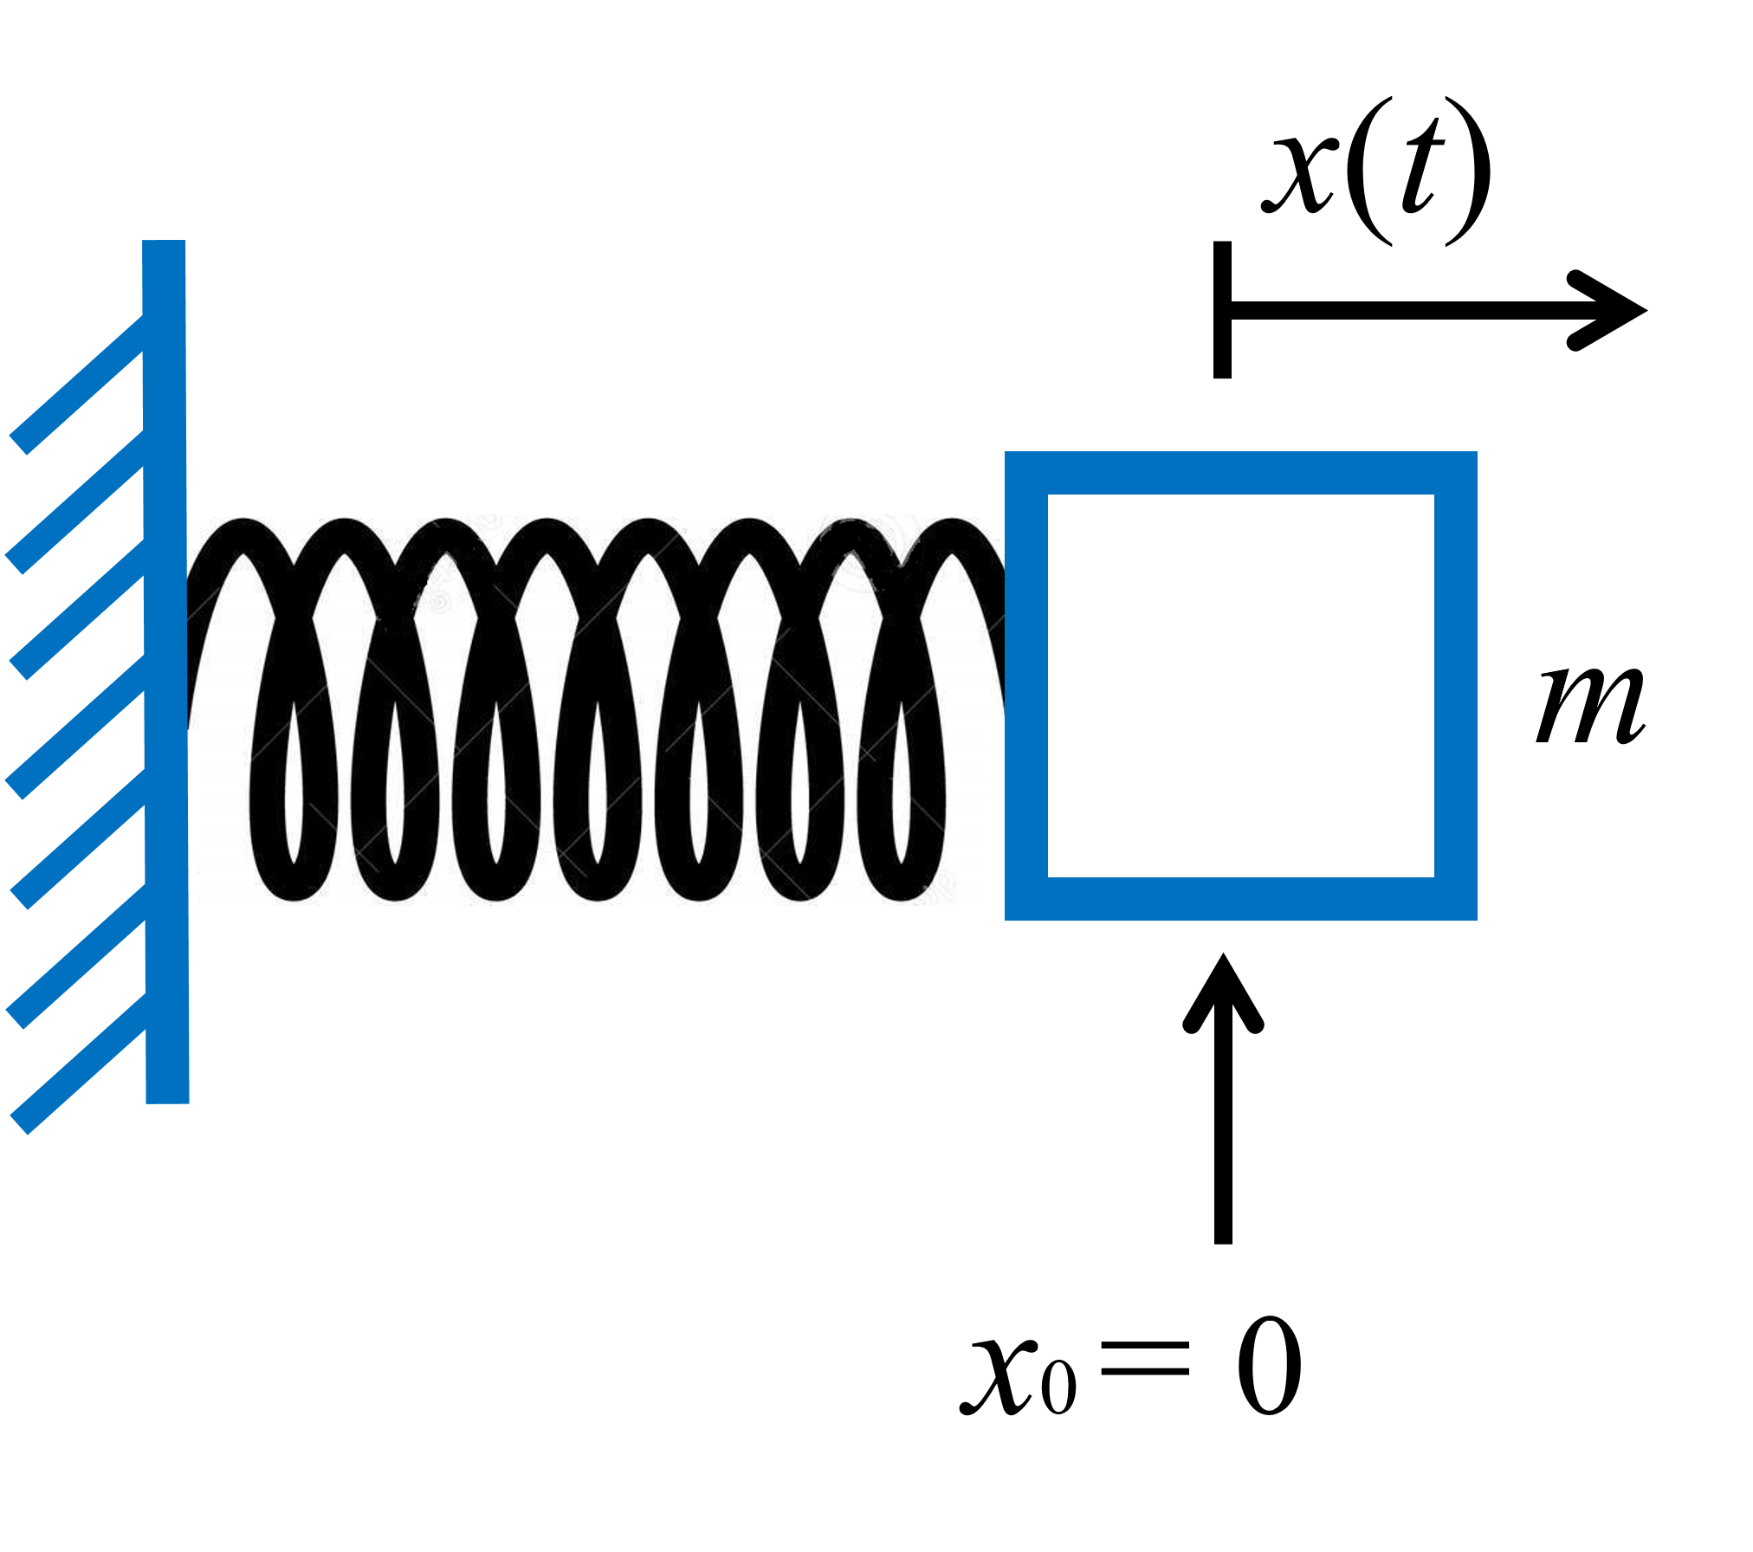
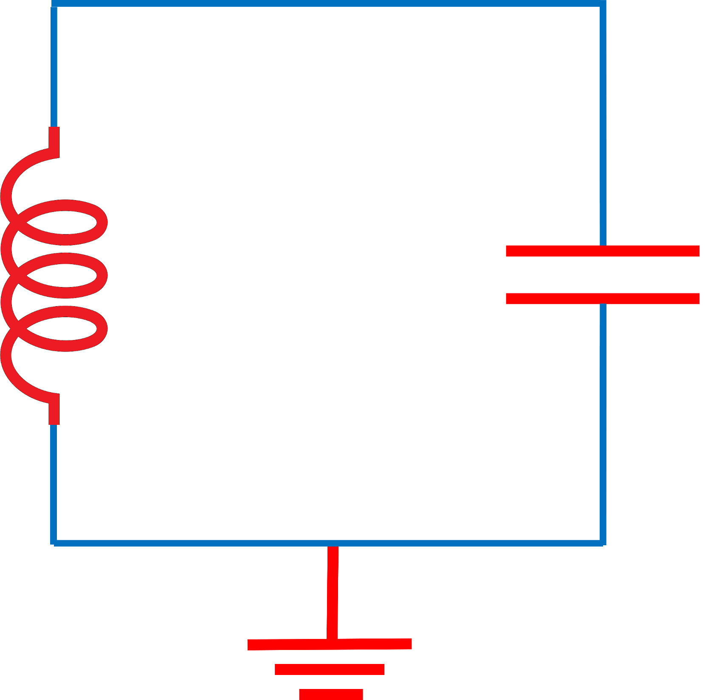

Slide 3
$x$(t)
$$m$$
$x_{0}$ = 0

Slide 5
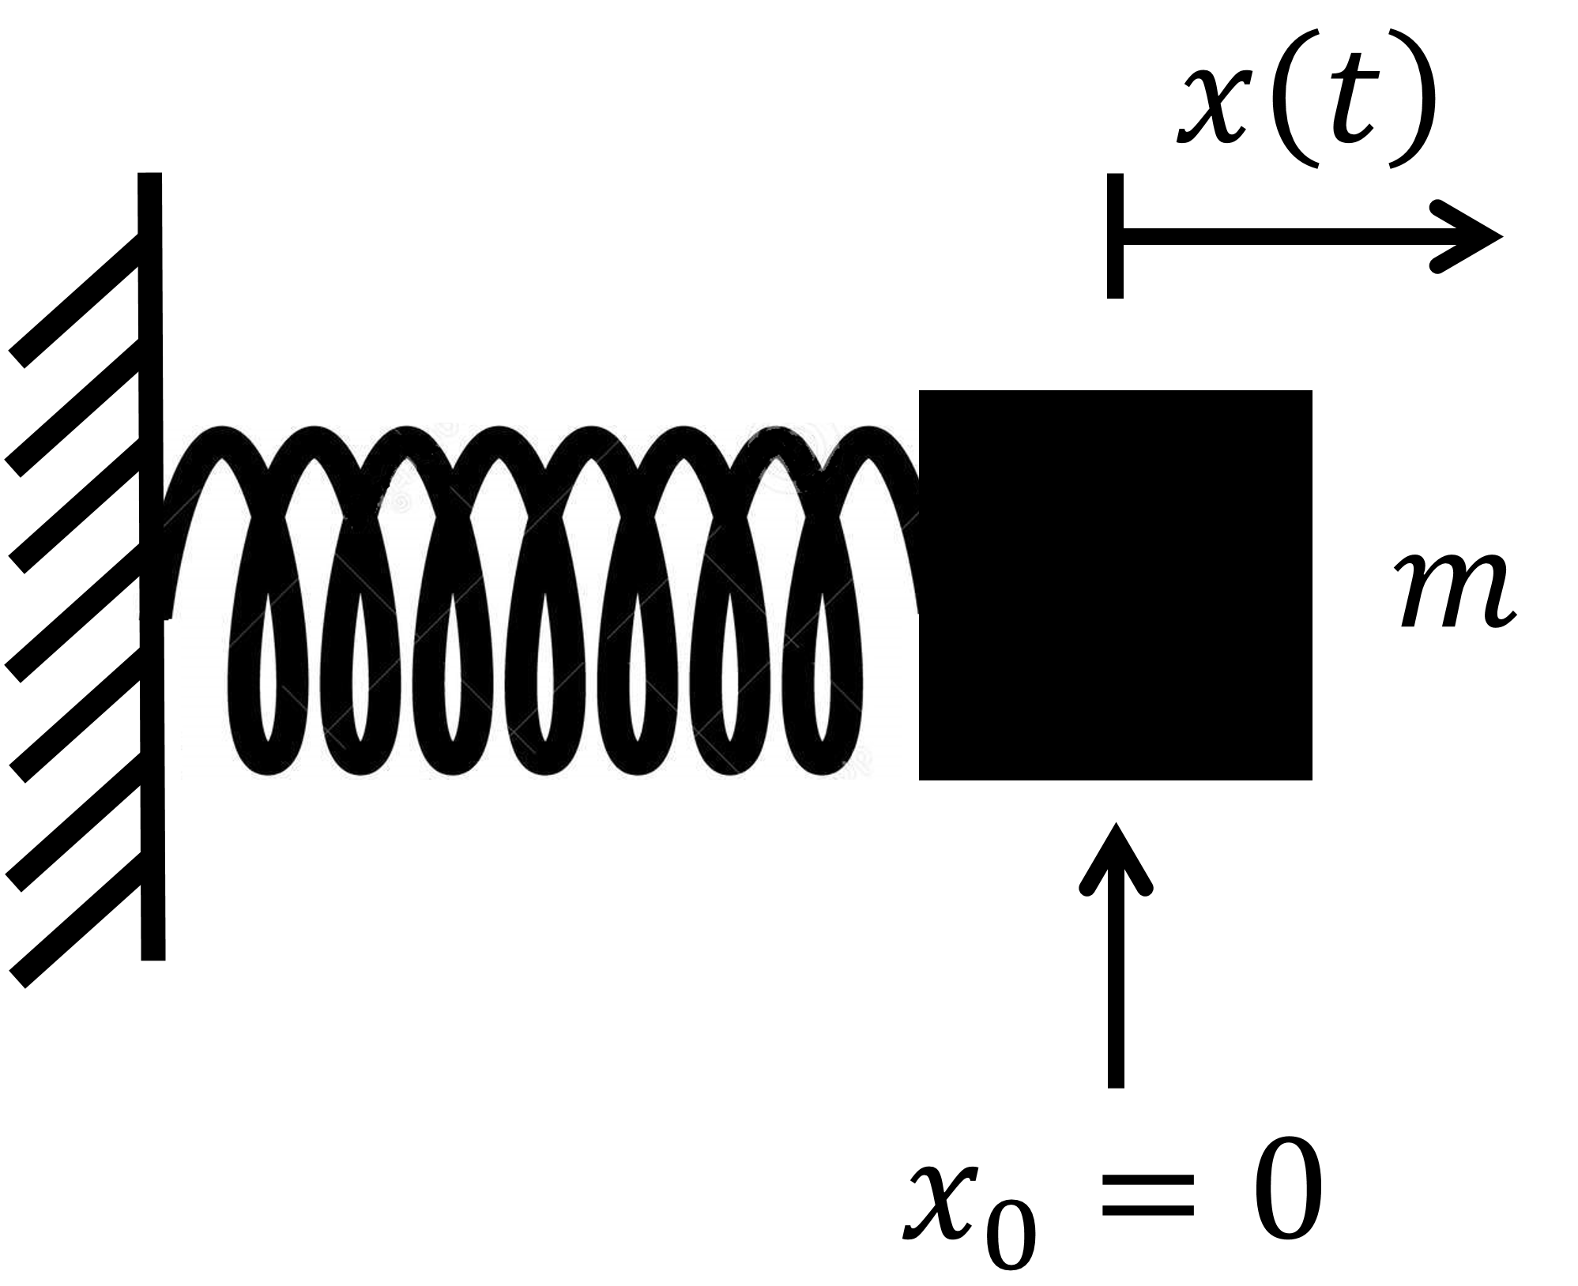
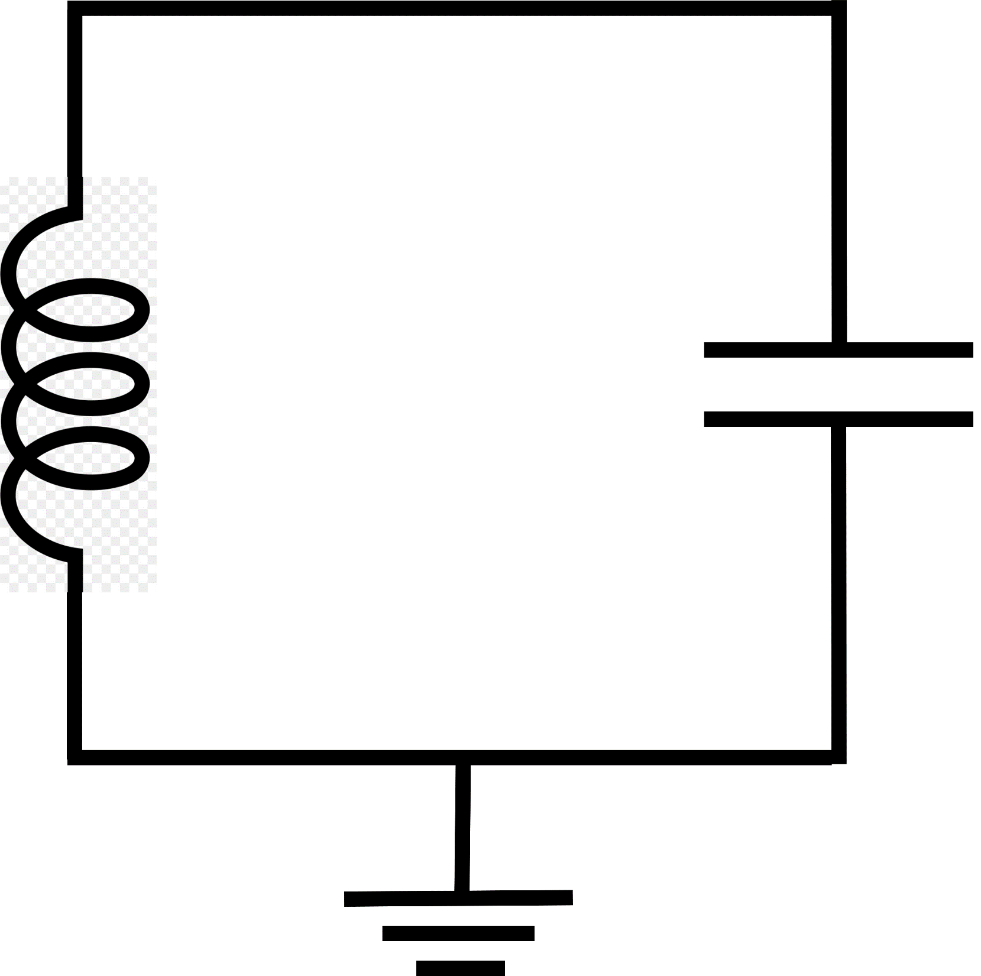
$$I\left(t\right)$$
(a)
(b)
$$+$$
L
$$C$$
$$V\left(t\right)$$
$$−$$

Slide 6
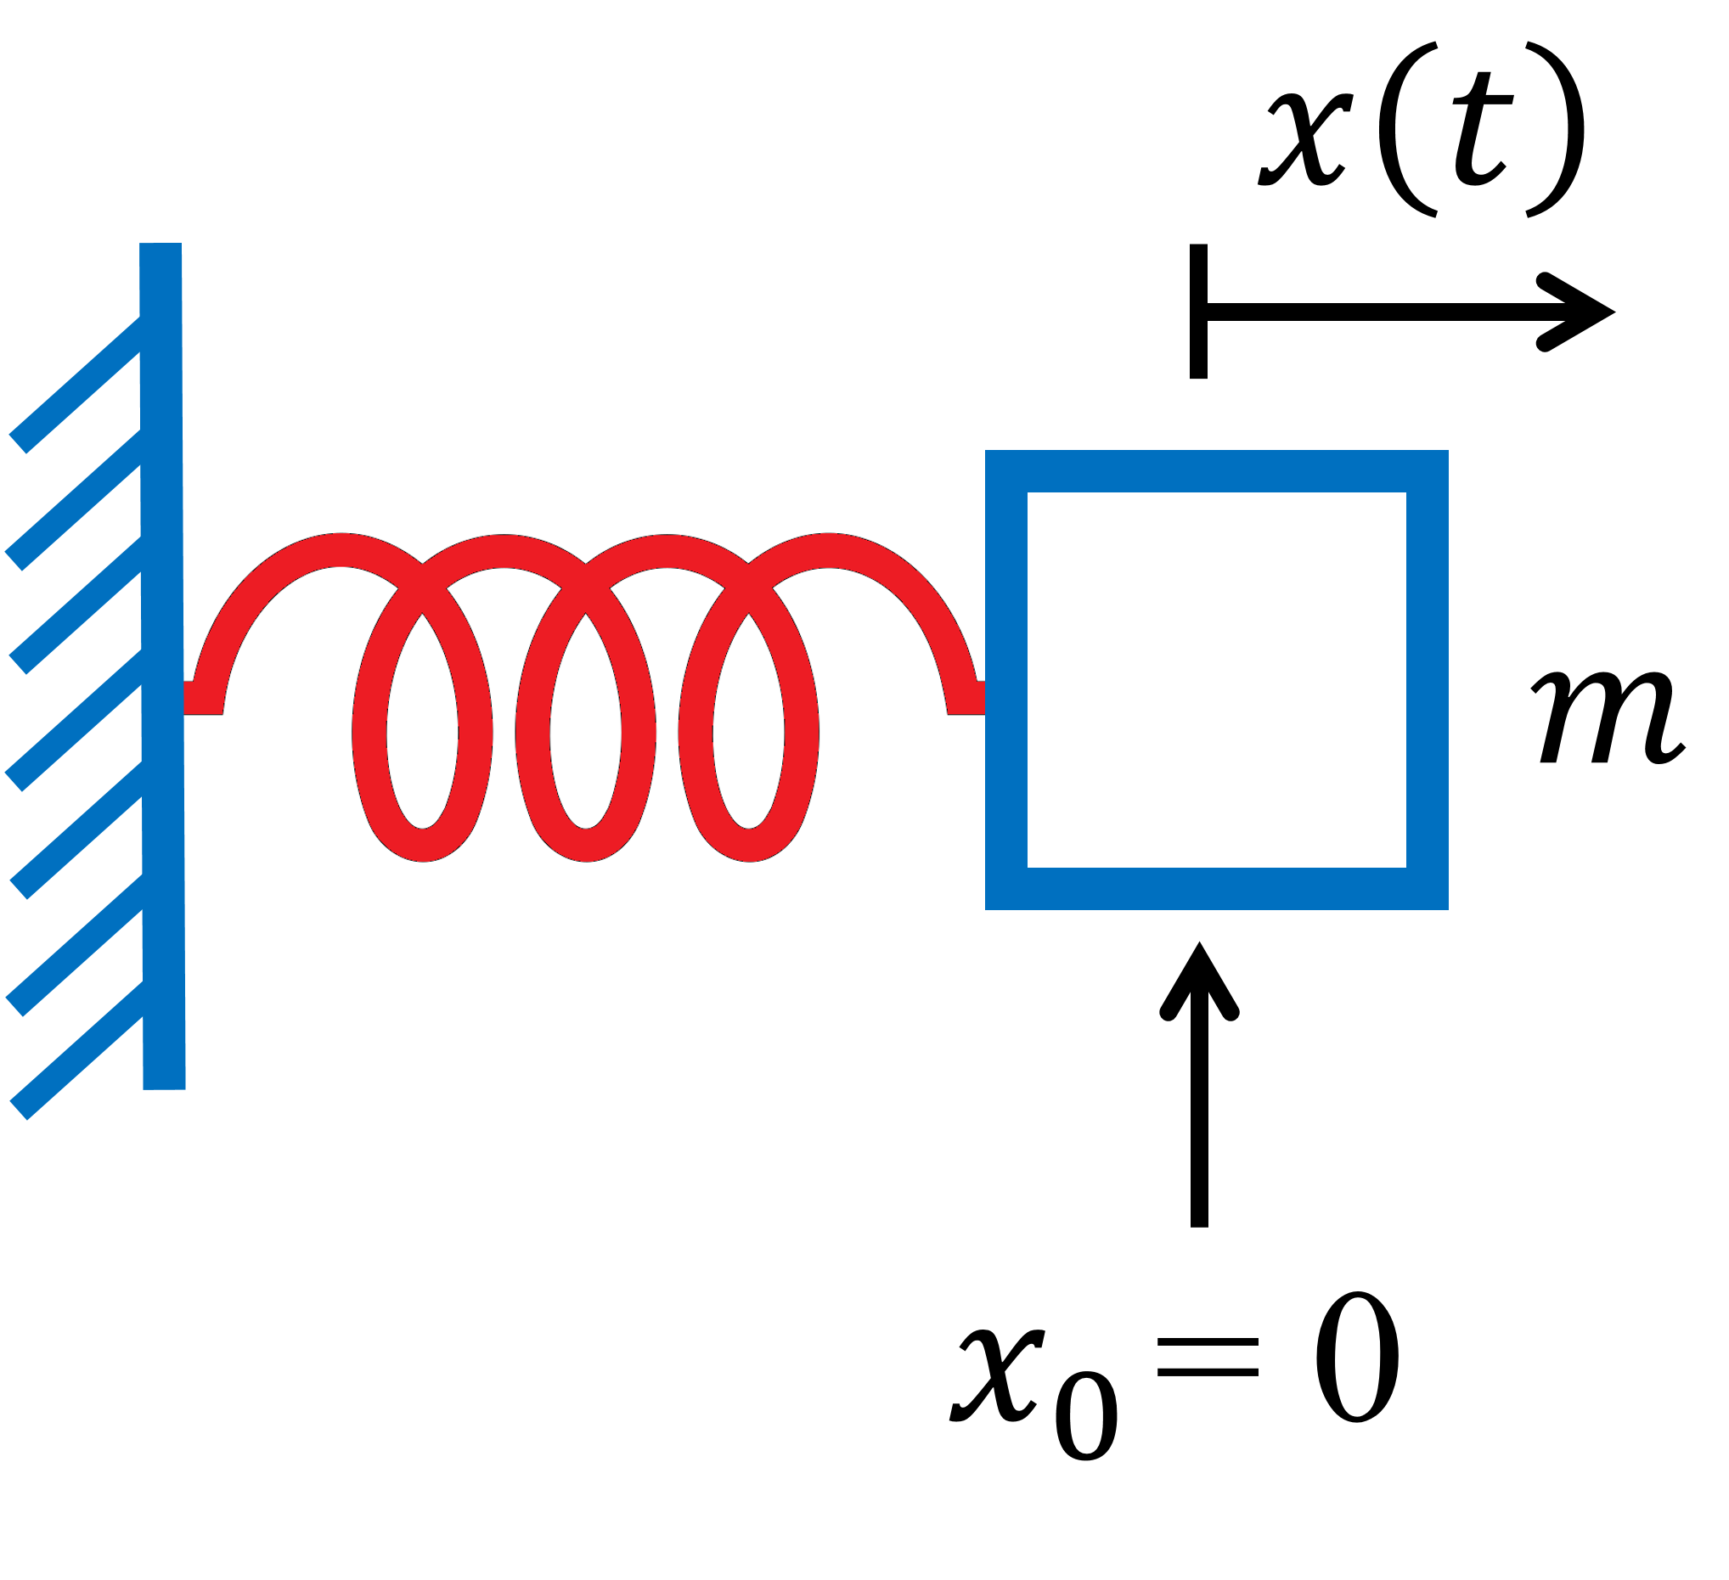
$$I\left(t\right)$$
(a)
(b)
$$+$$
L
$$C$$
$$V\left(t\right)$$
$$−$$

Slide 7
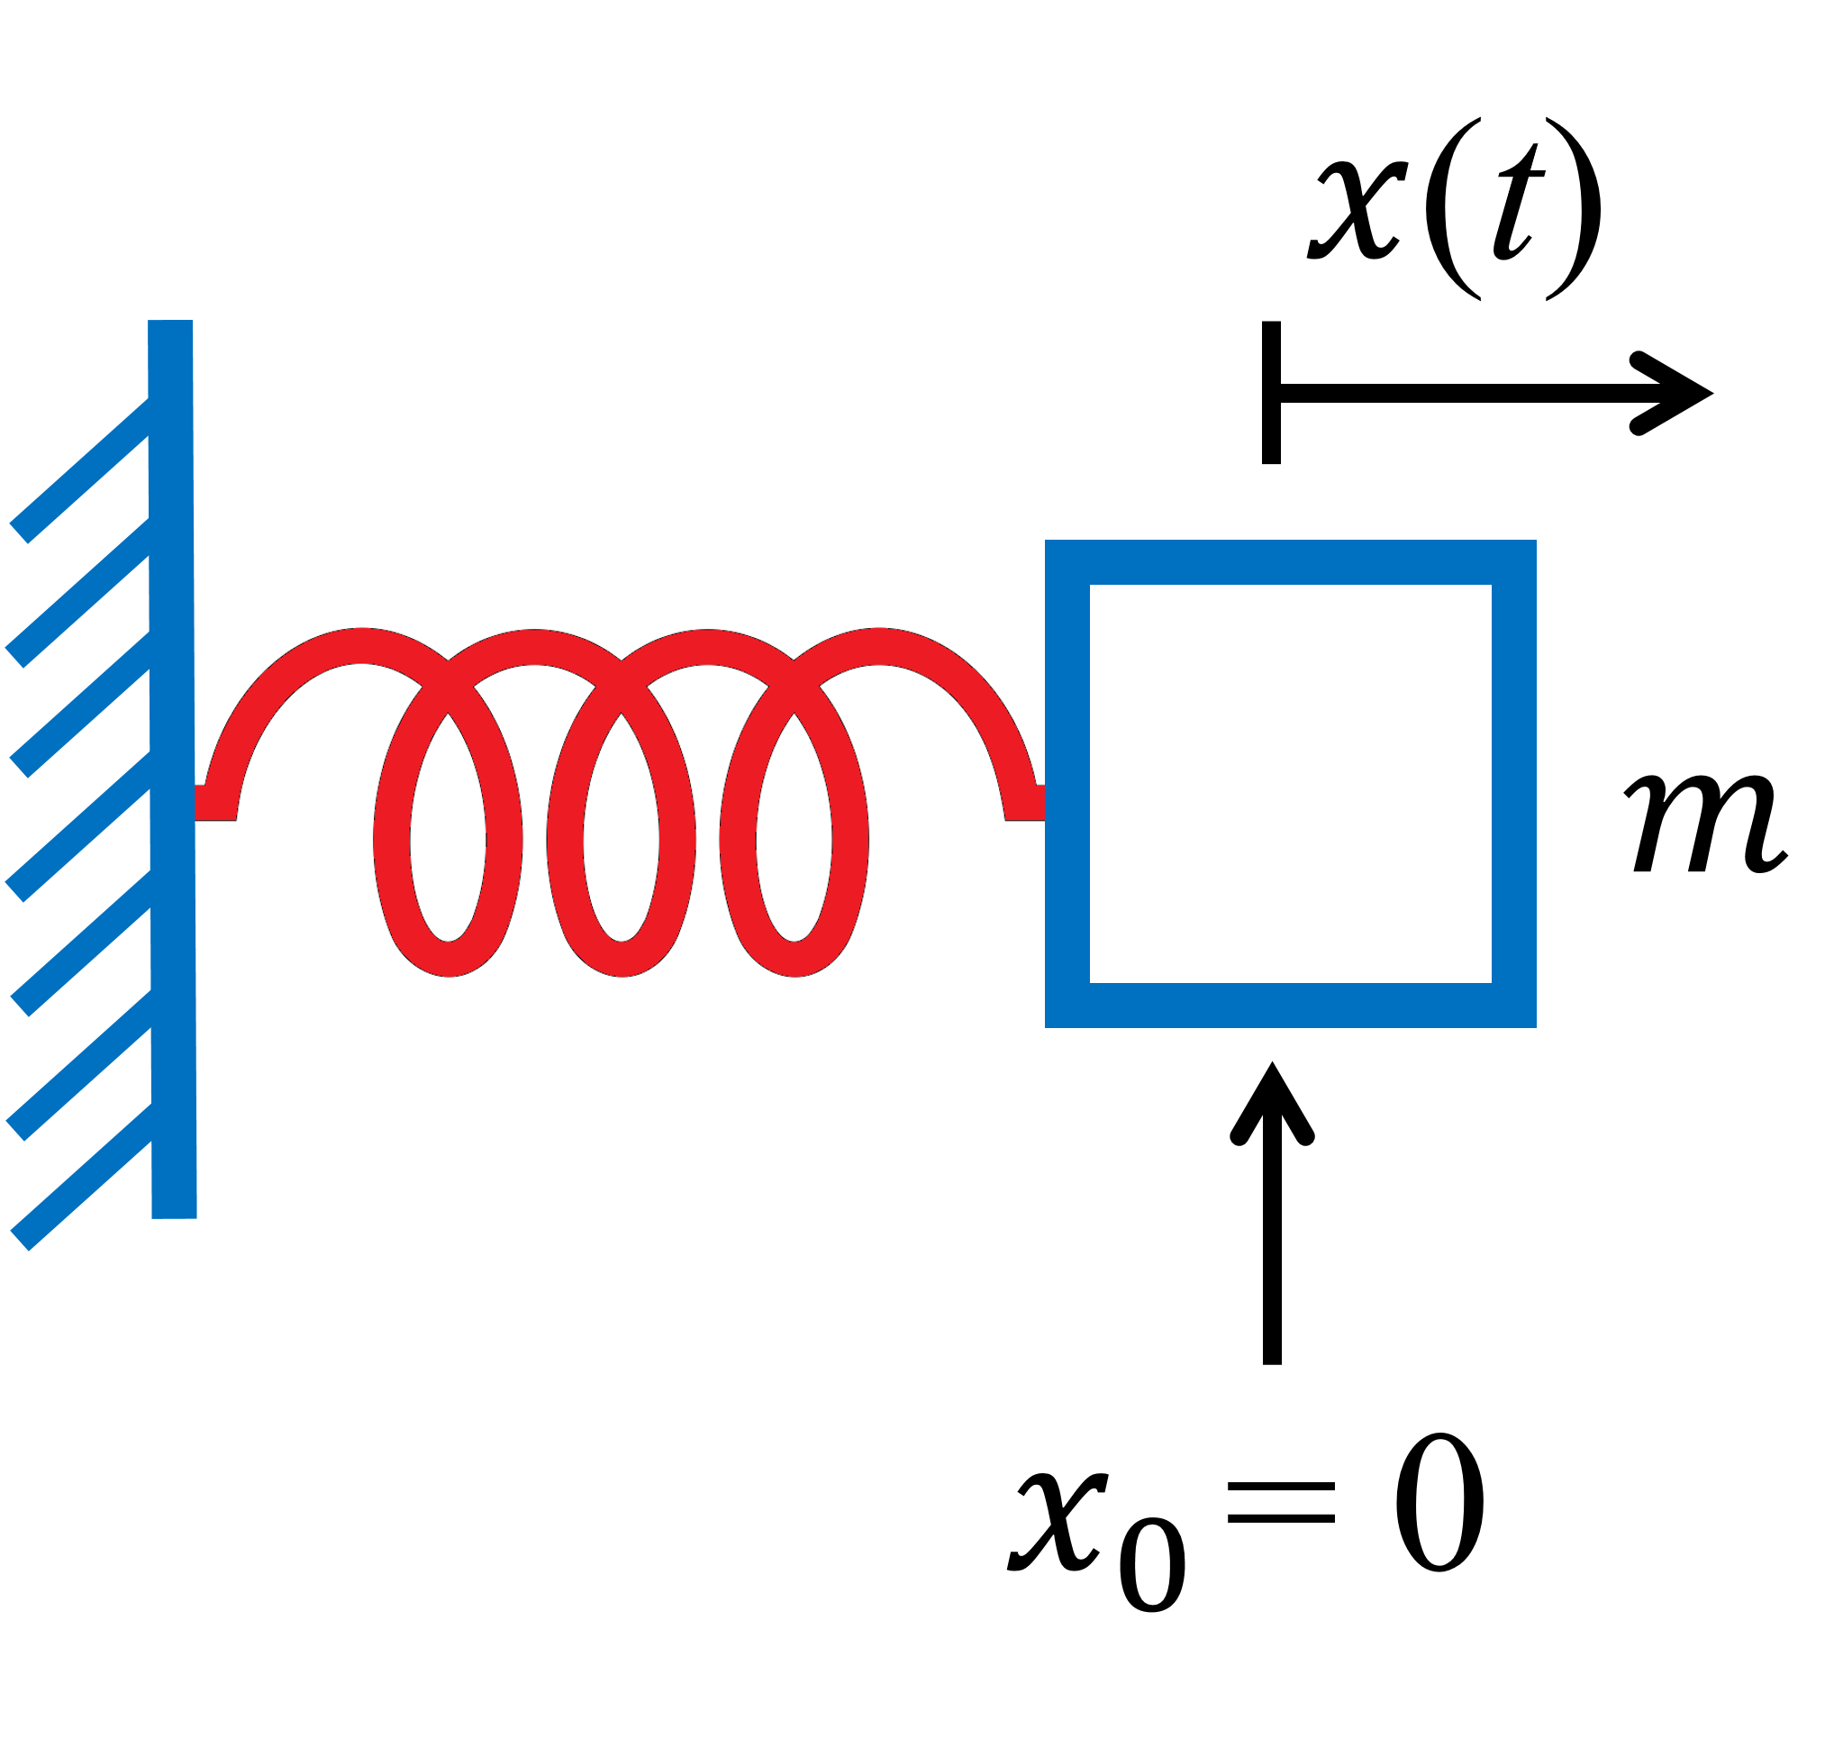
$I$(t)
(a)
(b)
$$+$$
L
C
$V$(t)
$$−$$

Slide 10
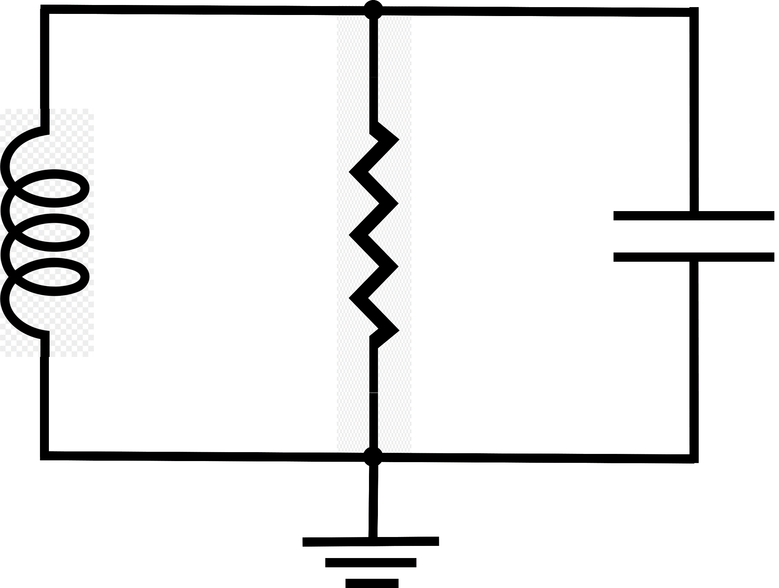
$$I_{L}\left(t\right)$$
$$I\left(t\right)$$
$$I_{L}−I$$
$$+$$
$$V\left(t\right)$$
$$−$$

Slide 11
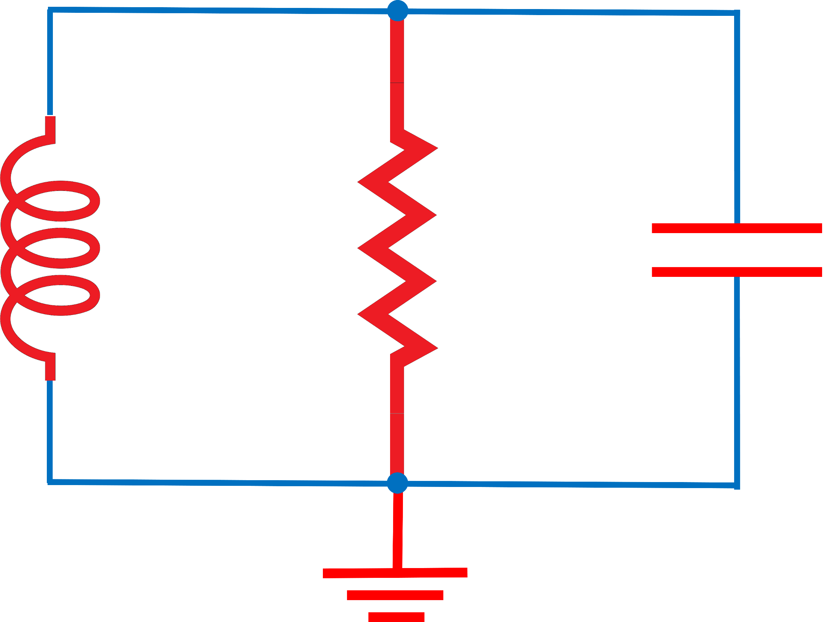
$I_{L}$(t)
$I$(t)
$$I_{L}−I$$
$$+$$
$V$(t)
$$−$$

Slide 12
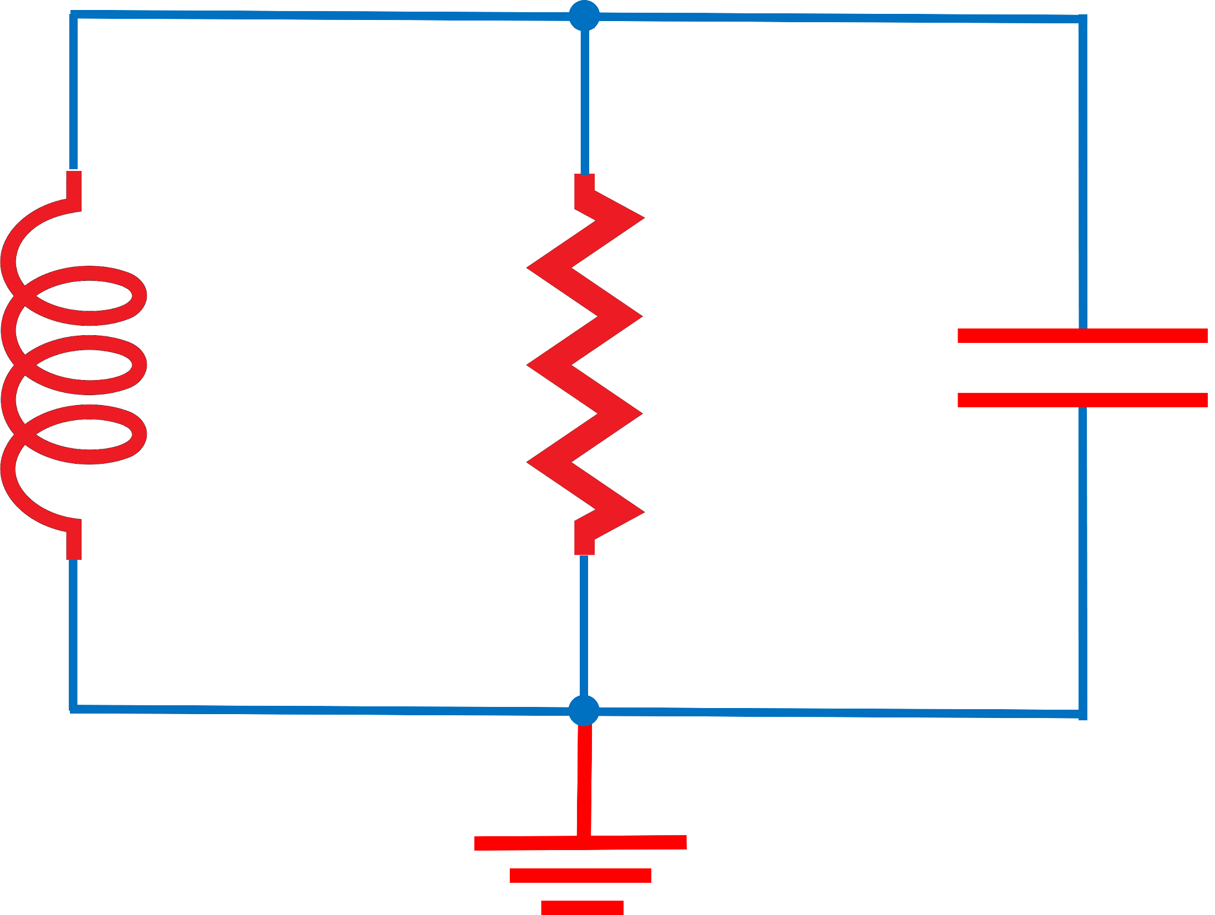
$I_{L}$(t)
$I$(t)
$$I_{L}−I$$
$$+$$
$V$(t)
$$−$$

Slide 13
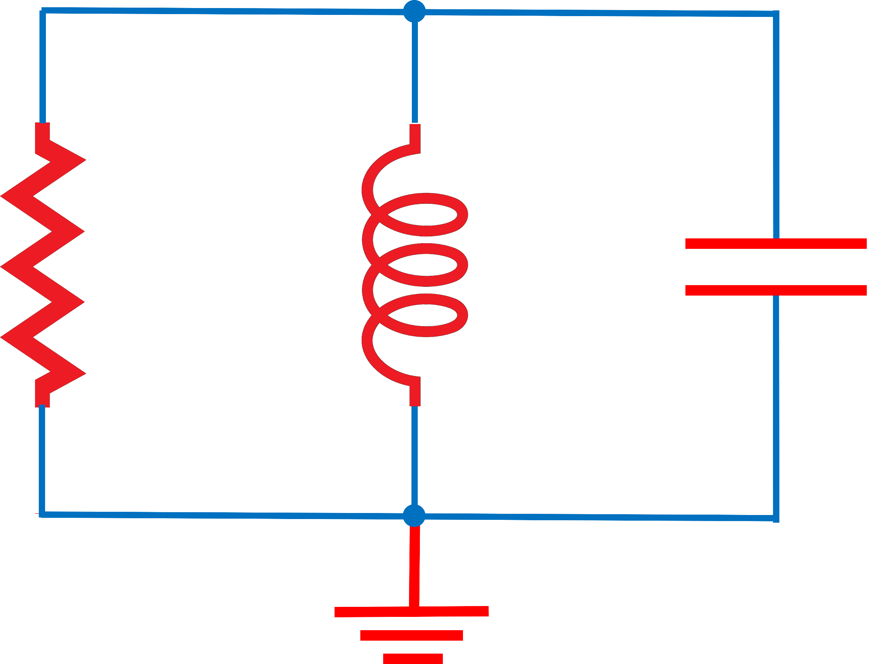
$I$(t)
$I_{L}$(t)
$$I_{R}\text{(}\text{t}\text{)}$$
$$+$$
$V$(t)
$$−$$

Slide 15
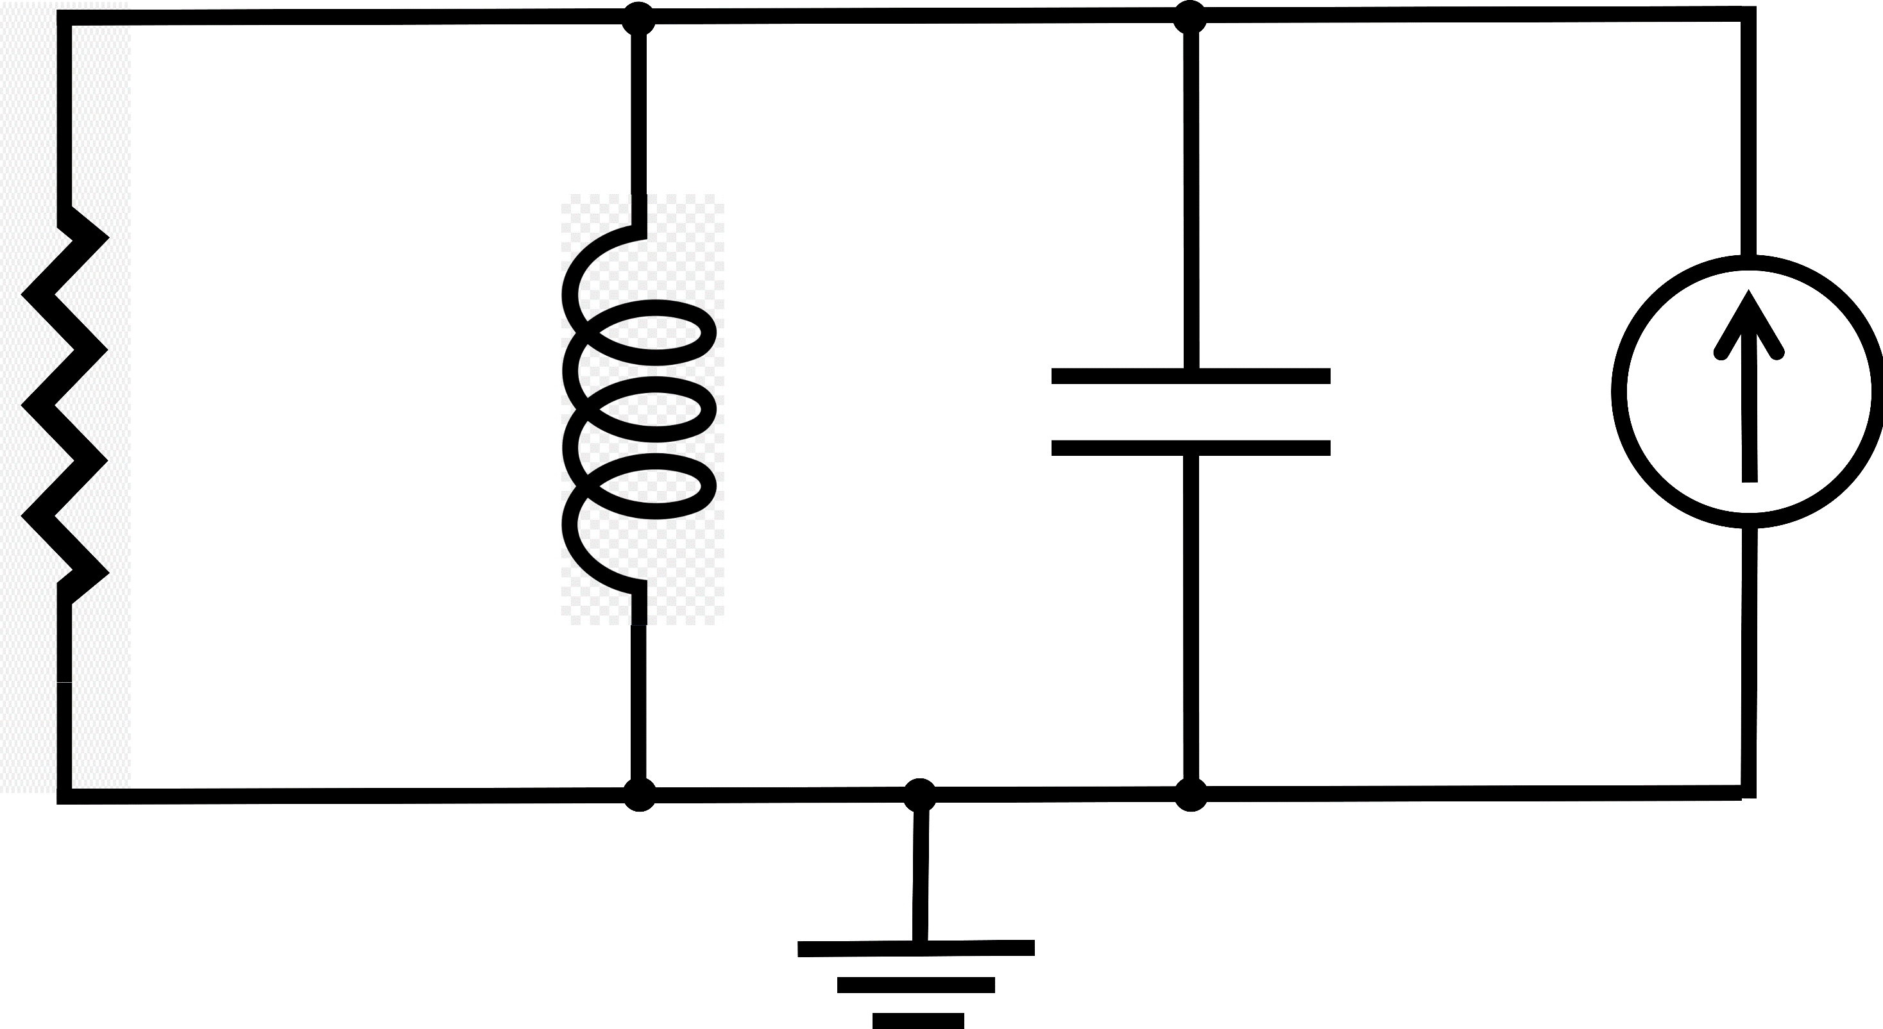
$$I_{R}$$
$$I_{L}$$
$$I$$
$$+$$
$$R$$
$$L$$
$$C$$
$$J$$
$$−$$

Slide 16
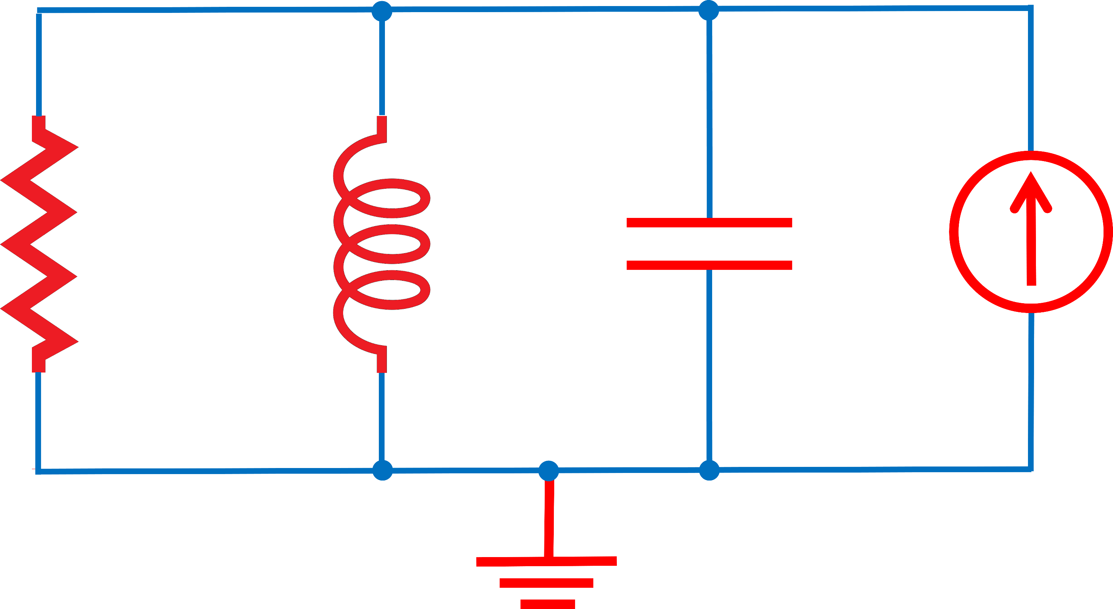
$$I_{R}$$
$$I_{L}$$
$$I$$
$$+$$
R
L
C
J
$V$(t)
$$−$$

Slide 17
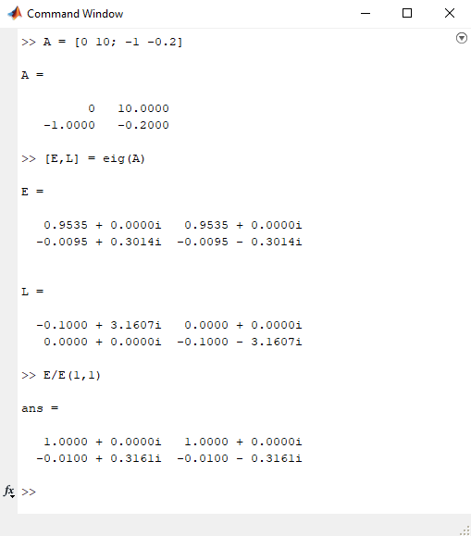
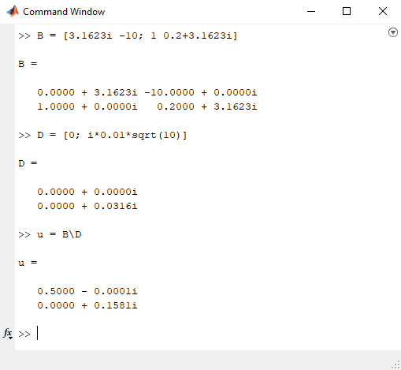
(a)
(b)

Slide 18
$${\tilde{u}}_{2}$$
$${\tilde{u}}_{1}$$

Slide 19
$${\tilde{u}}_{2}$$
$${\tilde{u}}_{1}$$

Slide 20
(a)
(b)
$${\tilde{u}}_{2}$$
$${\tilde{u}}_{2}$$
$${\tilde{u}}_{1}$$
$${\tilde{u}}_{1}$$

Slide 21
(a)
(b)
$${\tilde{u}}_{2}$$
$${\tilde{u}}_{2}$$
$${\tilde{u}}_{1}$$
$${\tilde{u}}_{1}$$

